Slide 1


Data Modelling
PYTHON IN FINANCE

Slide 2

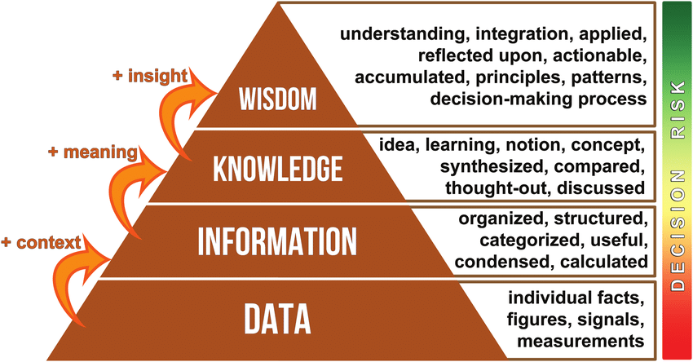
Data
DIGITAL PIONEERS
READINGS
https://searchdatamanagement.techtarget.com/definition/data
https://www.youtube.com/watch?v=sIjSY05JE9Q

Slide 3
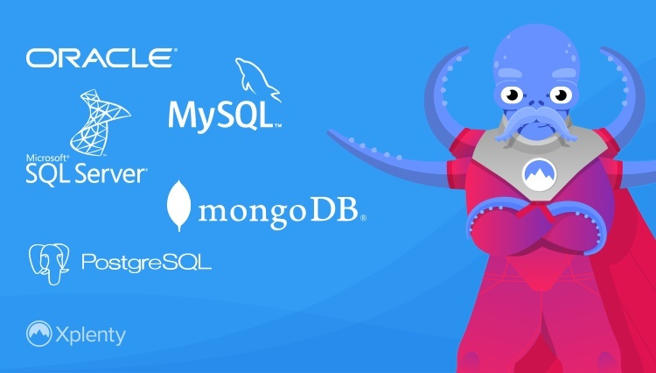
Database
DIGITAL PIONEERS
Relational Database
  mySQL
  Oracle
  MSSQL
NoSQL – non-relational
  MongoDB
READINGS
https://www.youtube.com/watch?v=ZS_kXvOeQ5Y
https://www.youtube.com/watch?v=4qFZ-5i4GS8

Slide 4
Big data
DIGITAL PIONEERS
What is Data?
The quantities, characters, or symbols on which operations are performed by a computer, which may be stored and transmitted in the form of electrical signals and recorded on magnetic, optical, or mechanical recording media.
What is Big Data?
Big Data is also data but with a huge size. Big Data is a term used to describe a collection of data that is huge in volume and yet growing exponentially with time. In short such data is so large and complex that none of the traditional data management tools are able to store it or process it efficiently.
READINGS
https://builtin.com/big-data
https://www.youtube.com/watch?v=sFvNC9eX12I

Slide 5
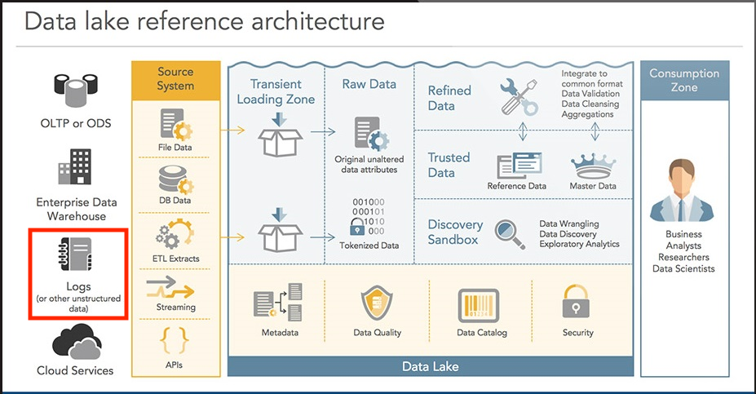
Data Lake
DIGITAL PIONEERS
READINGS
https://builtin.com/big-data
https://www.youtube.com/watch?v=sFvNC9eX12I

Slide 6

Database Design
DIGITAL PIONEERS
Table & Entity
READINGS
https://www.datanamic.com/support/lt-dez005-introduction-db-modeling.html

Slide 7
Database Design
DIGITAL PIONEERS
Table & Entity
Example
READINGS
https://www.datanamic.com/support/lt-dez005-introduction-db-modeling.html

Slide 8
Database Design
DIGITAL PIONEERS
Primary Key & Foreign Key
Example
READINGS
https://www.youtube.com/watch?v=hjgJZtLgB4w

Slide 9
Database Design
DIGITAL PIONEERS
Field & value type
Numeric
Text
Boolean
Date and Time
More …
READINGS
https://www.mysqltutorial.org/mysql-data-types.aspx

Slide 10
Database Design
DIGITAL PIONEERS
Normalization
Example
READINGS
https://www.youtube.com/watch?v=y03oYWDLu0Q

Slide 11
Database Operations
DIGITAL PIONEERS
Create DB
Create Tables
Queries
A lot more…
Example
READINGS
https://www.educba.com/mysql-queries/?source=leftnav

Slide 12
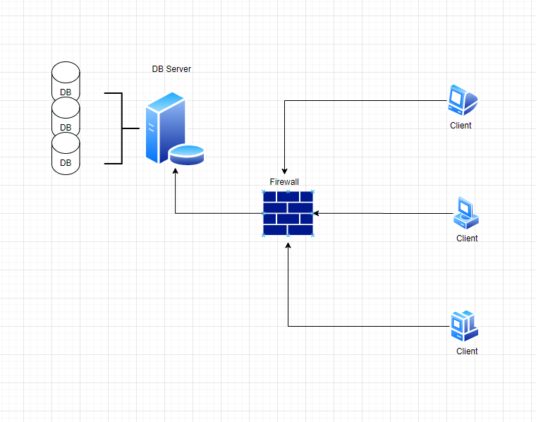
MySQL
DIGITAL PIONEERS
Server side
Client side
  MySQL Workbench 8.0
READINGS
https://www.youtube.com/watch?v=y03oYWDLu0Q

Slide 13
MySQL
DIGITAL PIONEERS
Example
READINGS

Slide 14
Python to MySQL
DIGITAL PIONEERS
Example
READINGS
https://www.youtube.com/watch?v=x7SwgcpACng&list=PLB5jA40tNf3tRMbTpBA0N7lfDZNLZAa9G

